Slide 1

MEDICAL INSURANCE PREMIUM PREDICTIONS
HIMANSHU PRAJAPATI
RIYA SINGH
SALINI MAHAPATRA

Slide 2

CONTENTS
Problem Statement
Variables for prediction
Data exploration
Machine learning models
Model evaluation
Recommendations

Slide 3

Problem Statement
Balancing Affordability and Sustainability: Insurance companies must set premium rates that are both affordable for policyholders and sustainable for the company.
Complex Factors at Play: Premium prediction involves considering a multitude of factors.
Maintaining Competitiveness and Profitability: Insurers must account for variables like healthcare costs and inflation to stay competitive and profitable.
Developing Predictive Models: The objective is to create robust predictive models using historical data and advanced analytics techniques.
Positive Outcomes: Accurate predictions improve risk assessment, pricing accuracy, customer satisfaction, and financial stability for insurers.
Fair and sustainable coverage : This benefits both insurers and policy holders,fostering a more efficient and equitable healthcare insurance ecosystem.

Slide 4


Variables for prediction
Independent Variables
Dependent variable
Age
Height
Weight
Diabetes
Blood Pressure
Any chronic disease
Known allergies
History of cancer in family
Number of major surgeries
Premium price

Slide 5
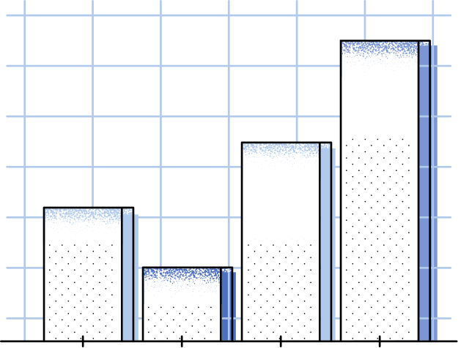
DATA EXPLORATION
We have used tableau to gain a better understanding of the content ,structure and patterns in the dataset. This is done to inform subsequent analysis and decision making.

Slide 6

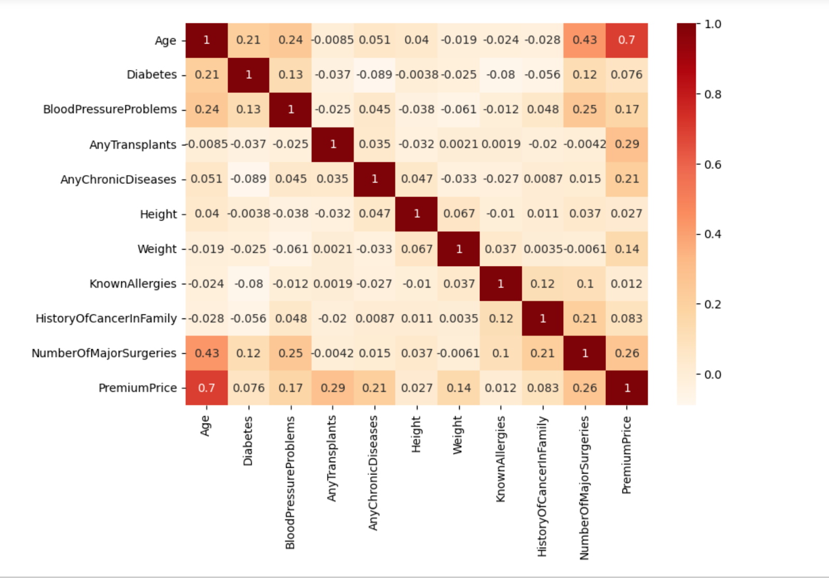
Feature
correlation
Age has the highest correlation
value for determining premium price.
Having transplants and major
surgeries are the next 2 important features.

Slide 7
MACHINE
LEARNING
MODELS
Multiple linear Regression
Boosted regression tree
Random forest regression
Artificial neural network
Genetic algorithm

Slide 8
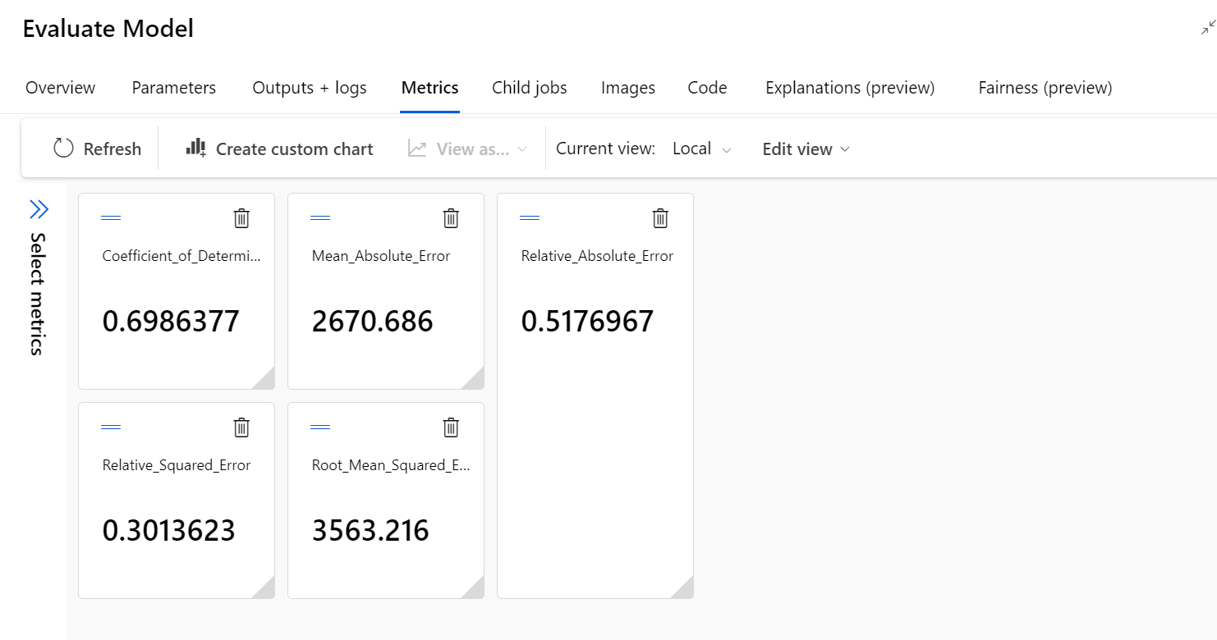

Multiple Linear regression
It is a statistical method used for modeling the relationship between a dependent variable and one or more independent variables by fitting a linear equation to the observed data.

Slide 9
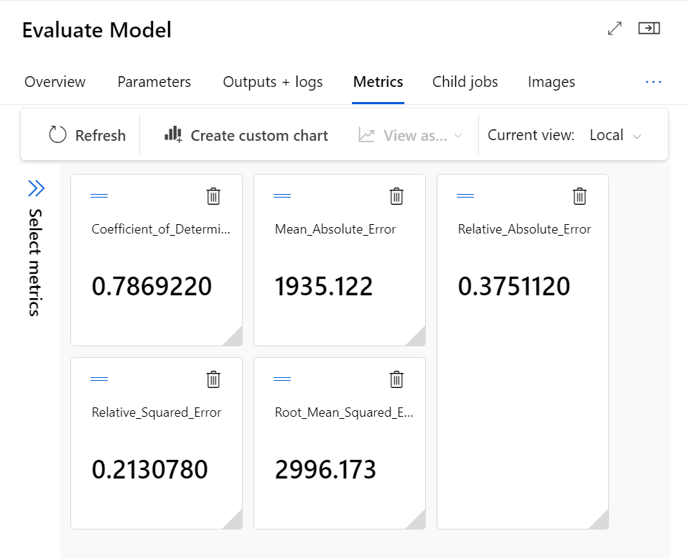
Boosted regression Tree
A boosted regression tree is a machine learning ensemble technique that combines multiple decision trees to create a powerful predictive model. It iteratively builds new trees, giving more weight to the data points that the previous trees have misclassified, effectively improving prediction accuracy and capturing complex relationships in the data.

Slide 10
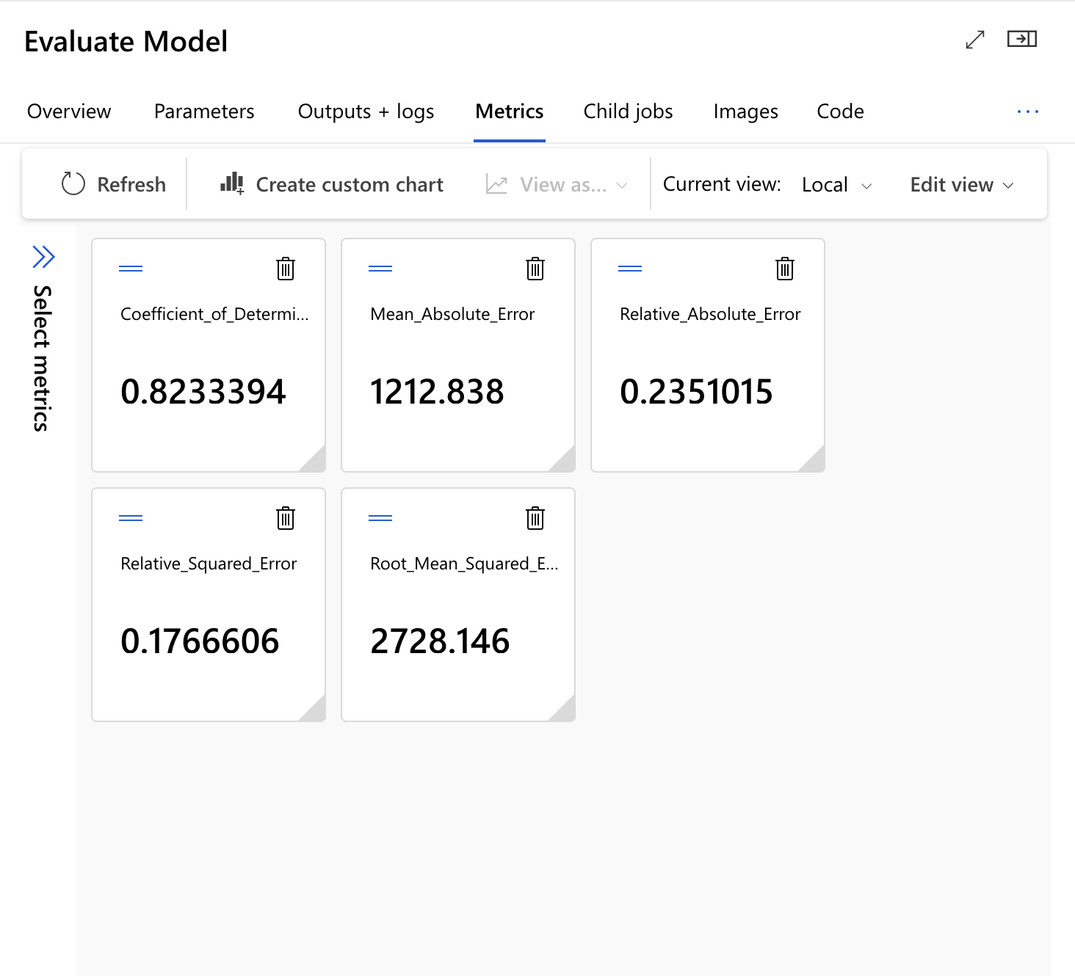
Random Forest regression
A regression forest is a machine learning ensemble method that consists of multiple decision trees trained to perform regression tasks. These trees collectively predict a continuous target variable by averaging or combining the individual predictions, resulting in a robust and accurate regression model.

Slide 11
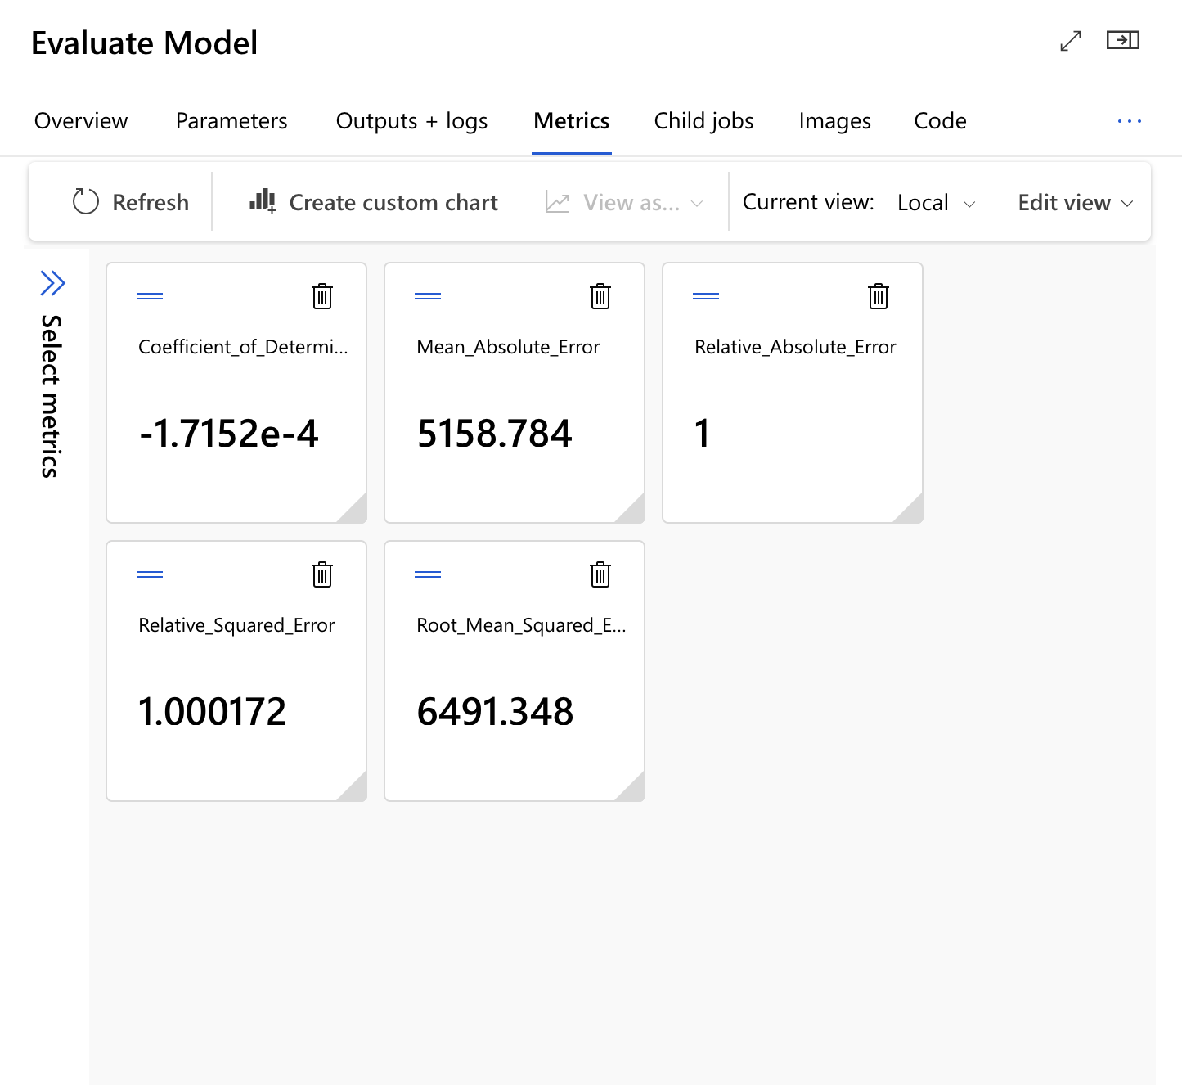
Artificial neural
network
A neural network is a computational model inspired by the structure and function of the human brain. It consists of interconnected nodes (neurons) organized into layers, where information flows through weighted connections, enabling the network to learn and make predictions or classifications from data through a process called deep learning.

Slide 12
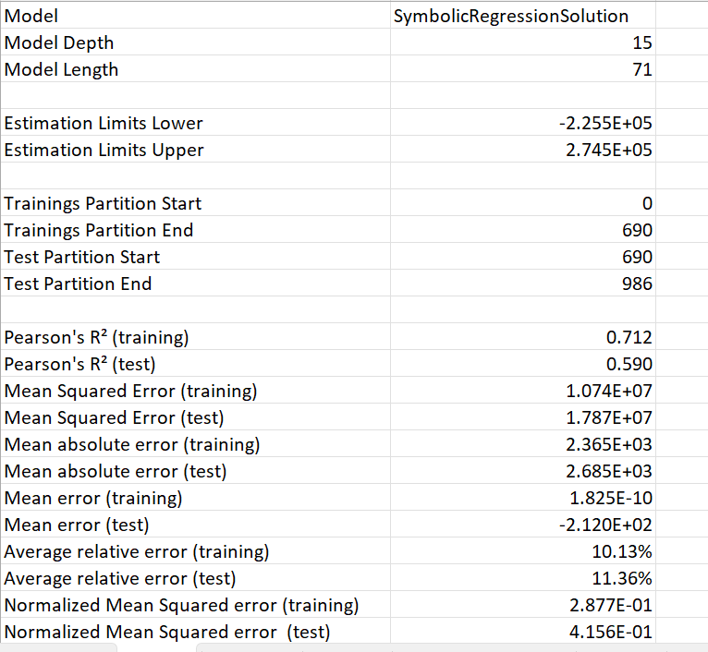
Genetic Algorithm
A genetic algorithm is a computational optimization technique inspired by the process of natural selection and genetics. It involves the evolution of a population of potential solutions over multiple generations, using genetic operators like mutation, crossover, and selection to search for the best possible solution to a given problem.

Slide 13
MODEL
EVALUATION
After careful consideration of two determining factors i.e. :
Coefficient of determination
Root mean squared error
We have concluded that regression forest is the best model to move
forward with the prediction of medical insurance premiums.
The value says that the model is not overfitted and should perform well on new data.

Slide 14




Recommendation
Key Insights from Health Insurance Analysis
Utilized Random Forest Regression for premium cost estimation.
Age is the most influential factor in determining insurance costs.
Major surgeries and organ transplants significantly impact premium rates.
Non-diabetic individuals have higher premiums, suggesting pricing
revision.
Hypertension has minimal influence, indicating the for streamlined
risk assessment.
Proposed Strategy
Enhance pricing model to include age, surgeries, and transplants.
Evaluate and potentially revise pricing for non-diabetic individuals.
Improves precision and competitiveness for the organization and
policyholders

Slide 15

Thank You

